Slide 1


LEGO MINDSTORMS PROGRAMMING CAMP
Robotics Programming 101
Camp Curriculum

Slide 2
Instructor Notes
Every day of camp, we started with a short video showing FLL robots, real robots or something relevant to the day’s lesson
We switched between using powerpoint slides and showing the actual EV3 software environment
We created some add-on challenges for students who finished early
We created a new project each day
We did not show the challenge solution slide unless someone needed help.

Slide 3
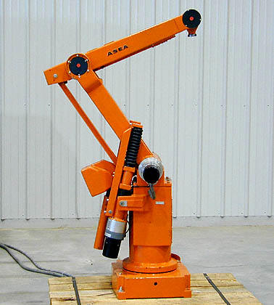
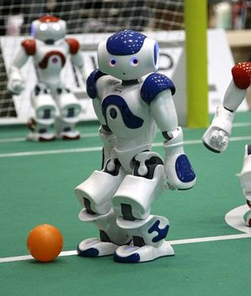
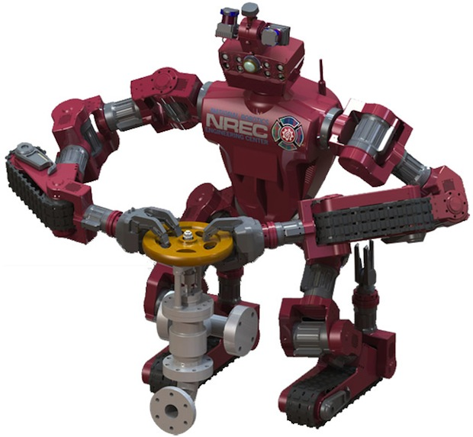
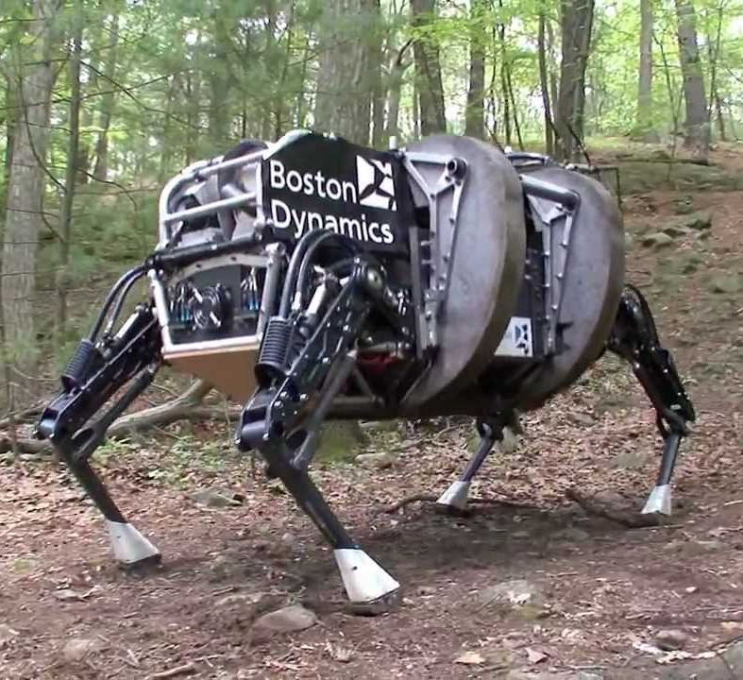
What is a robot?
Robots are machines in factories, play soccer, are in research labs, behave like animals….
We will use the LEGO MINDSTORMS

Slide 4
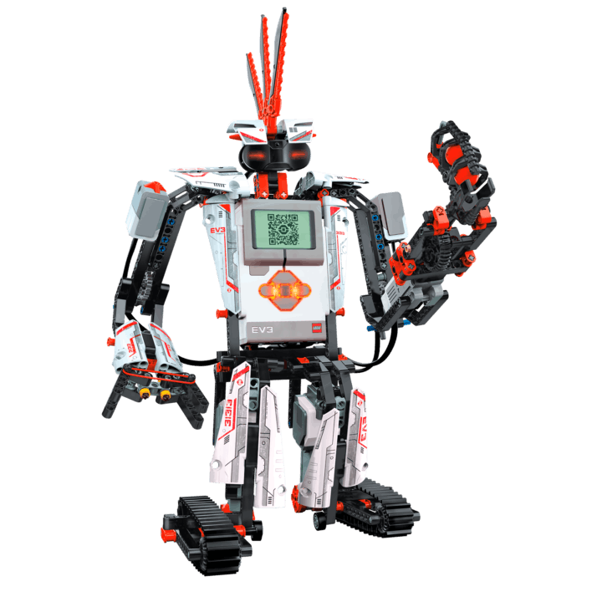
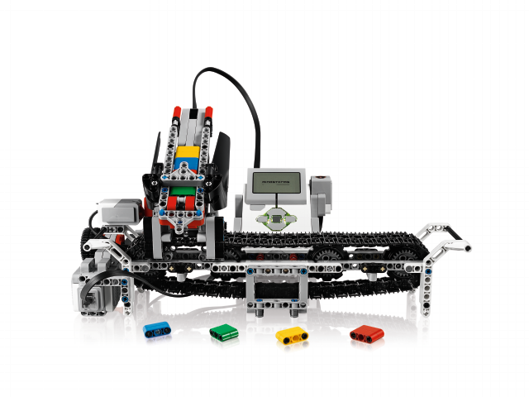
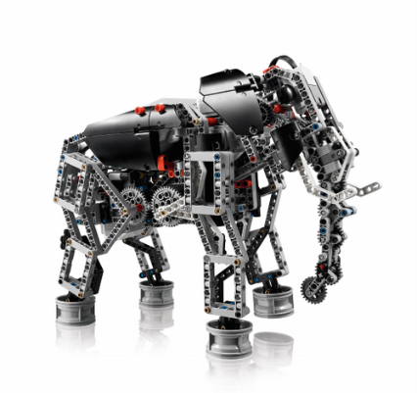
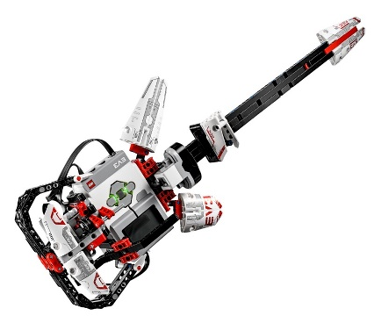
Lego Mindstorms Robots
You can place a video of your choice here to introduce FLL/Lego robotics

Slide 5
Dos and Do Nots this week
Share the laptop and the robot
Work together in your group
Help each other finish each challenge
Lift the robot by the handle
Take Turns
Do not drop, throw, push on the robot – they are very expensive
Treat your computer well – they are expensive

Slide 6
What will we do this week?
Learn basic EV3-G Programming
Make a Mindstorms robot follow your instructions
Learn how to make your robot move straight, turn, repeat actions, choose between actions and follow lines
Have FUN with robots and get inspired to learn more!!

Slide 7
Instructor Notes
We use the CyberBot NXT design – please note the location of the color sensor
We use the NXT brick but program with the EV3 software. The NXT brick has less memory.
You will have to delete the files often (at the end of every session)
Students who create and use a lot of sound files will fill in the brick faster.
We asked students to make a new project file each day for their programs.

Slide 8

BEGINNER EV3 PROGRAMMING Lesson: Introduction
Topics Covered:
NXT Basics
Introduction to the NXT Brick and EV3 Software

Slide 9
Lesson Objectives
Learn how the NXT brick operates
Learn about the main components of the EV3 software

Slide 10
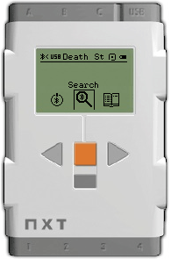
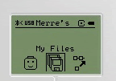
The “Brick” Buttons
1 = Left, Right → Navigate menus
2 = Center Button → Select options Run Program Turn robot on
3 = Back → Undo Stop Program Turn robot off
2
1
1
3

Slide 11
The “Brick” Screen
Menus on Screen
My Files Find programs you downloaded
2. Use left/right
buttons to find other menus such as “View”

Slide 12
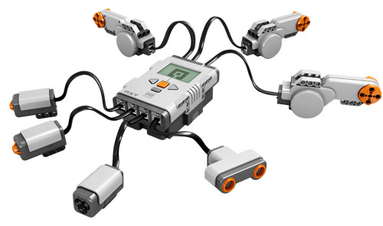
Ports, Sensors, motors
Motors: make your robot move
Ports A, B, C = Motors
Default setup assumes Right Motor is in C, Left Motor is in B
Touch Sensor: Make your robot detect objects
Ultrasonic sensor: Make your robot measure distances
Color sensor: Make your robot detect colors
B
Default setup
Front
Ports 1, 2, 3, 4 = Sensors
C

Slide 13
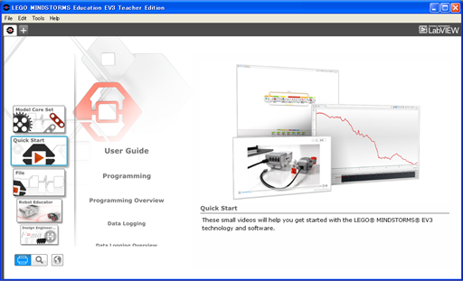
EV3 Software
Open Saved Project
Create New Project

Slide 14
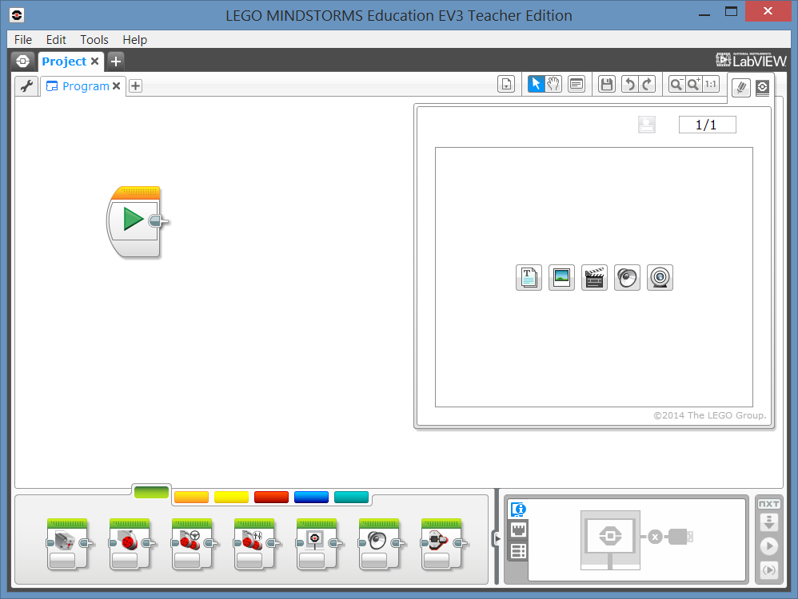
EV3 Software: Saving your project
File..Save Project As
Save project on desktop as “CampPM1”
Each project can contain multiple programs.
You will create a new project for each day this week.

Slide 15
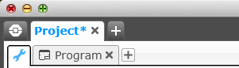
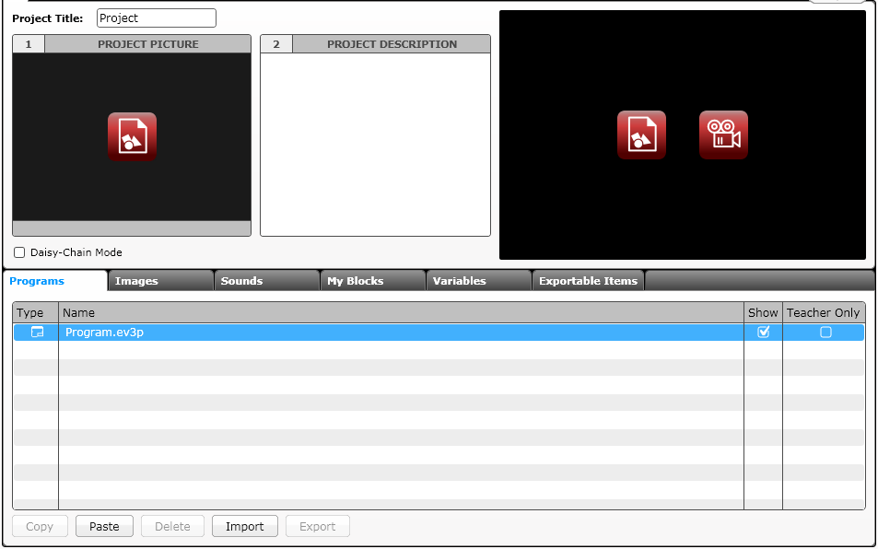
EV3 Software: Starting A new program
Create a Project
Opened Programs
Opened Projects
Create a Program
Project Properties
List of programs

Slide 16
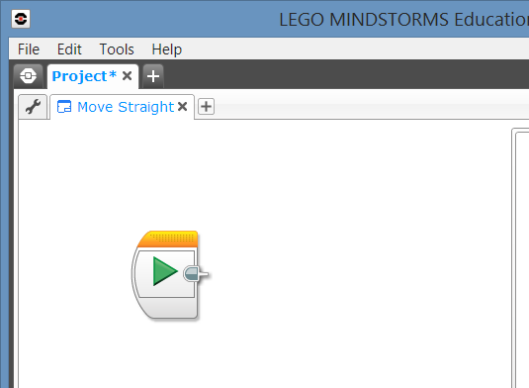
EV3 Software: Naming your program
Double click on Program
Change name of program to “Move Straight”

Slide 17
PROJECTS VS. PROGRAMS
You will start by creating a PROJECT which has a .ev3 extension. You change the name of a project by using the Save Project As option from the the File menu.
You will write many PROGRAMS as part of each PROJECT file. You change the name of a program within a project by doubling clicking on the program’s tab and typing in a new name.
Note: If there is an * next to the project name, you have made changes to the project and you have not yet saved yet.
There is a “x” next to project and program names. Clicking on it simply closes the file (it does not get deleted).

Slide 18
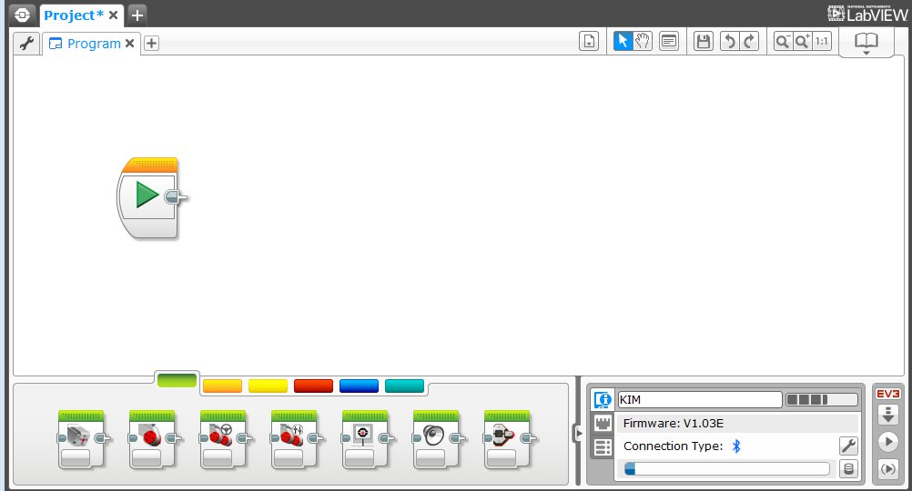
EV3 Software: Programming screen
Click on a program tab to bring up the programming canvas.
Programming Area or Canvas
Programming Blocks in
6 Colored Tabs
Brick Status & Downloading

Slide 19
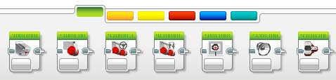
EV3 Blocks: Colored Tabs
ACTION BLOCKS
Move, Large & Medium Motor, Display…
FLOW BLOCKS
Start, Wait, Loop, Switch, Loop Interrupt
SENSOR BLOCKS
Brick Buttons, Gyro, Color, Ultrasonic
1
2
3
1
2
3
4
5
6
DATA OPERATIONS
Variables, Array, Logic, Math, Compare…
ADVANCED BLOCKS
Data Logging, Unregulated Motor…
MY BLOCKS
Custom Blocks you create
4
5
6

Slide 20

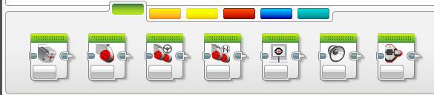
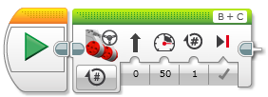
Adding Blocks To Your Program
STEP 1: Green Block Tab, Click and hold any block and drag to programming area
STEP 2: Drop next to the Start Block (green arrow)
(See animation)

Slide 21
EV3 PROGRAMMING Lesson: Moving Straight
Beginner Lesson: Moving Straight

Slide 22
Lesson Objectives
FINISH
Learn how to make your robot go forward and backwards
Learn how to use the Move Steering block
Learn how to read sensor values using View
1
2
B
START
C

Slide 23
How do you Move Straight?
STEP 1: Green Block Tab, Click and hold Move Steering and drag to programming area
STEP 2: Drop next to the Start Block (green arrow)
(See animation)

Slide 24
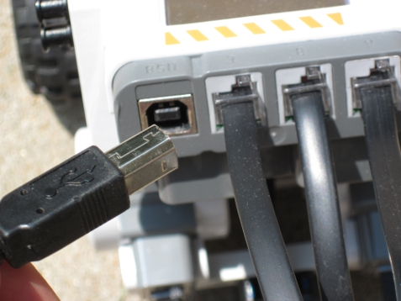
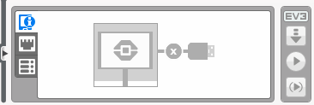
CHALLENGE 1: Move Straight
STEP 1: Green Block Tab, Click and hold Move Steering and drag to programming area
STEP 2: Drop next to the Start Block (green arrow)
STEP 3: Connect USB cable to NXT and Laptop.
STEP 4: Download to NXT
Step 3
Step 4

Slide 25
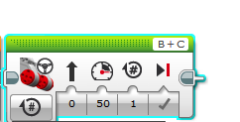
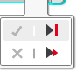
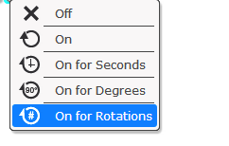
Move STEERING Block
B
C
Mode of operation
Brake/Coast
Steering: Straight or turn
Power/Speed
Duration/Distance

Slide 26
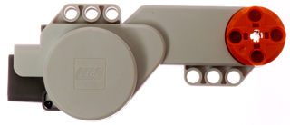
NEGATIVE & POSITIVE POWER: BACKWARD & FORWARD
Negative Power = Backwards
Positive Power = Forward

Slide 27
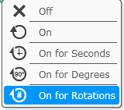
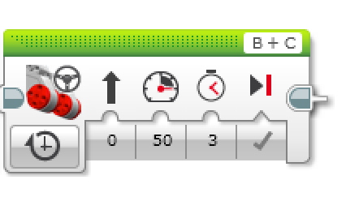
CHALLENGE 2: Move Straight (3 SECONDS)
Step 3
STEP 1: Green Block Tab, Click and hold Move Steering and drag to programming area
STEP 2: Drop next to the Start Block (green arrow)
STEP 3: Select Options. Move “3 Seconds”
STEP 4: Connect USB cable to NXTand Laptop.
STEP 5: Download to NXT
Step 4
Step 5

Slide 28
Move Straight: Seconds vs. degrees vs. rotations
FINISH
CHALLENGE: Move your robot forward from the start line to the finish line (1) and back to the start (2).
Try mode SECONDS, DEGREES or ROTATIONS and adjust duration/distance
Try different speeds
1
2
B
START
C

Slide 29
MOVE STRAIGHT discussion
Did you guess and check a lot?
Yes. Programming with seconds, rotations and degrees using guess and check takes a lot of time and effort.
Did changing the speed matter?
Yes. When you move in seconds your speed will matter.
Do you think the wheel size will matter? Why?
Wheel size affects degrees/rotations.
Do you this the battery level will matter? Why?
When you move in seconds, battery levels change the power.

Slide 30
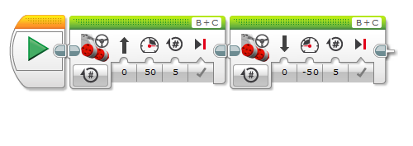
CHALLENGE SOLUTION
This would be changed for degrees or seconds
There is a better way (go to next slide) to solve this challenge

Slide 31
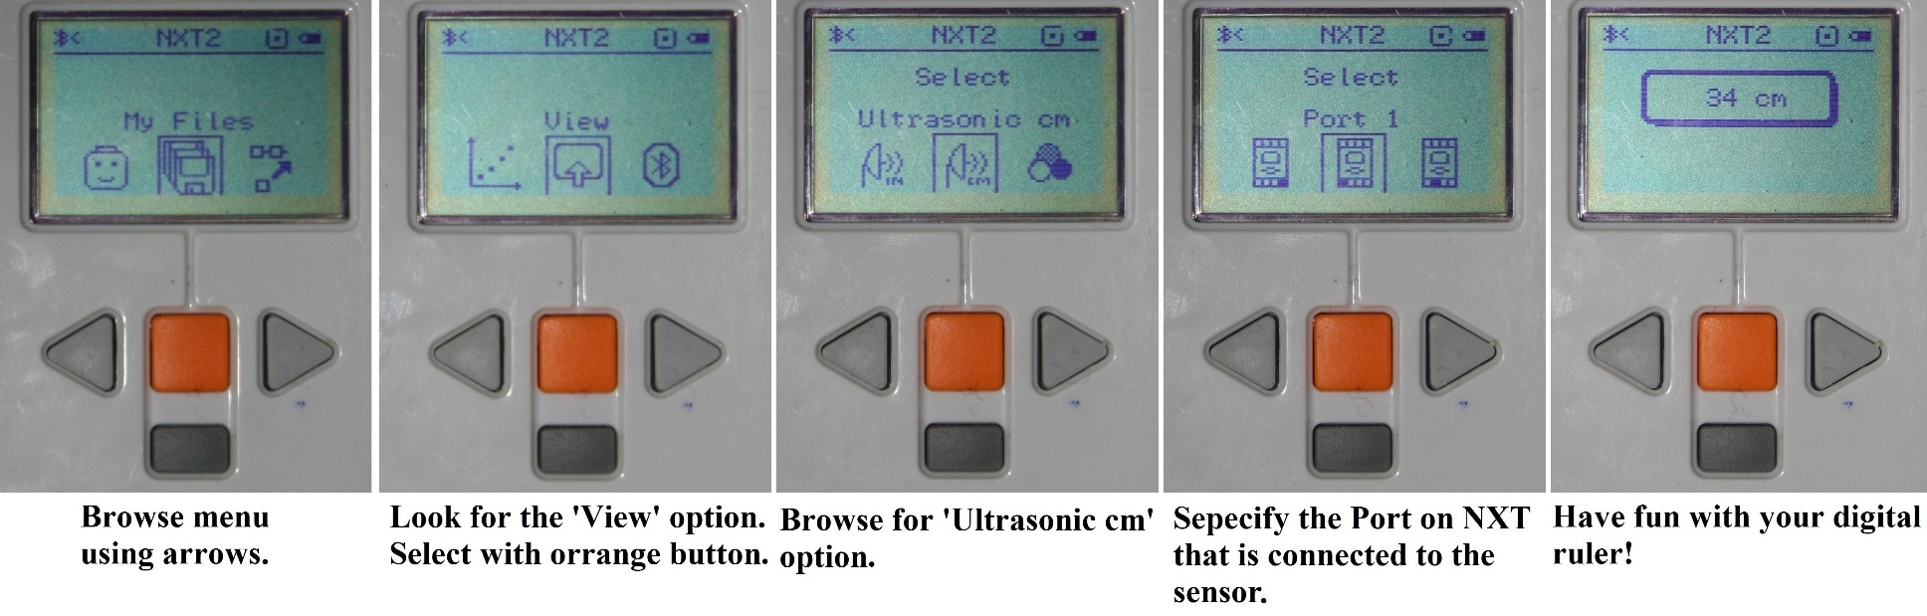
SOLUTION: Use View
Try “view” on brick (instruction below)
Move your robot with your hand from your start line to your end line
Read how many degrees your robot moved
Use this number in the Move Steering Block to move the correct distance.
Browse for ‘Motor degrees’ option

Slide 32
BEGINNER EV3 PROGRAMMING Lesson: Turning
Beginner Lesson: Turning

Slide 33
Lesson Objectives
Make a robot baseball player
Learn how to make the robot turn
B
Second Base
C
B
B
B
C
C
B
B
C
C
C
B
B
Start and End position
C
First Base
C

Slide 34
PIVOT Vs. SPIN Turns
180 Degree Pivot Turn
Notice where the robot ends in both pictures after a 180 degree turn.
In the Spin Turn, the robot moves a lot less and that makes Spin Turns are great for tight positions. Spin turns tend to be a bit faster but also a little less accurate.
So when you need to make turns, you should decide which turn is best for you!
B
End Position
Motor
B Moves
C
B
Start Position
C
180 Degree Spin Turn
Start Position
End Position
B
B
Motors
B and C Move
C
C

Slide 35
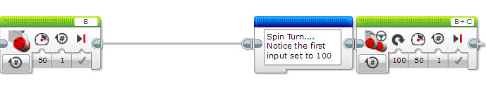
How to Make Pivot and Spin turns
Move Steering or Large Motor
Large Motor B | Large Motor C | Move Steering Steering=100 | Move Steering Steering=-100
Pivot Turn Right | Pivot Turn Left | Spin Turn Right | Spin Turn Left
B
B
B
B
C
C
C
C
Large Motor Block
Move Steering Block
Change Steering value here

Slide 36
Measuring Turns
Turns are measured in degrees
0/360
345
15
330
30
315
45
300
60
285
75
270
90
255
105
240
120
225
135
210
150
195
180
165

Slide 37
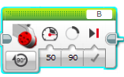
Making a Pivot turn for 90 Degrees
?
B
B
C
C
Program your robot to turn 90 degrees....Does the robot actually turn 90 degrees if you just pick 90 degrees for distance?
Ans. NO! This makes the wheel turn 90 degrees. The correct solution on next page

Slide 38
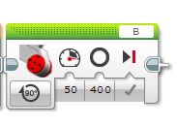
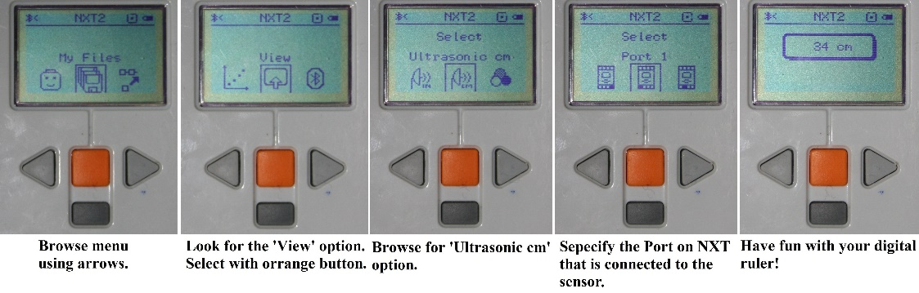
How do you make the robot turn 90 degrees?
Ans. Try using the port view to measure the turn and then input the correct number of degrees.
Motor degrees

Slide 39
TURNING CHALLENGES
Challenge 1
Challenge 2
Your robot is a baseball player who has to run to all the bases and go back to home plate.
Can you program your robot to move forward and then turn left?
Use a square box or tape
Your robot baseball player must run to second base, turn around and come back to first.
Go straight. Turn 180 degrees and return to the same spot.
Second Base
B
Start and End position
C
B
First Base
C

Slide 40
Class Discussion Guide
Did you try PIVOT and SPIN turns? What did you discover?
Pivot turns were fine for Challenge 1, but for Challenge 2, if we used Pivot turns, we were farther away from the base.
What situations would one work better than the other?
Spin turns are better for tight turns (places where there is not enough space) and you stay closer to your original position.

Slide 41
CHALLENGE SOLUTIONS
Challenge 1
Challenge 2
You probably used a combination of move steering to go straight and do pivot turns to go around the box.
You probably used a spin turn because it is better for tighter turns and gets you closer to the starting point!
Second Base
B
B
Start and End position
C
First Base
C

Slide 42
Review
What do these programs do?
What are the names of these blocks

Slide 43

BEGINNER EV3 PROGRAMMING Lesson : Display to the screen
Beginner Lesson: Display Blocks
By: Droids Robotics

Slide 44
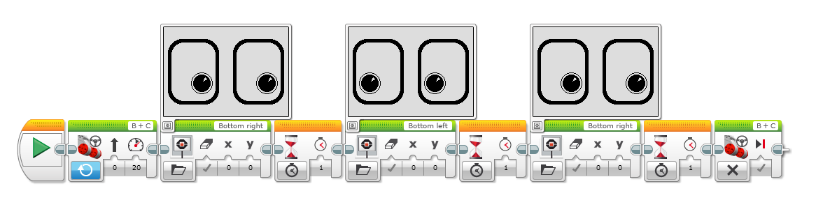
LESSON OBJECTIVES
Make the robot display some fun faces while moving!
Learn to use the Display Block to display text and images
Understand why the Display Block can be useful in programming

Slide 45
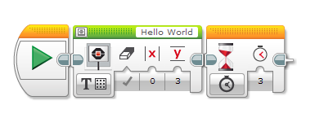
Display Block
The Display Block to show information and pictures on the screen
You can control the location and size of text
You can use this same block to display sensor readings and instructions.
Located in Green Tab
Display!!!!!

Slide 46
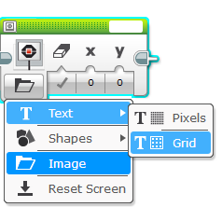
More on Display Blocks
Two modes to display
Pixel mode (Use for displaying images or text)
Gives fine control over placement of image/text
Grid mode (Easier to use, only works for text mode)
Accuracy of a single “line”
Click on top left of block to preview
Notes:
178 pixels left and right
128 pixels up and down
22 columns of 8 pixels each
12 rows of 10 pixels each

Slide 47
Displaying Text in Grid Mode
Step 1:
Pick Display Block
Step 2:
Click on “Switch Modes” icon and hover over “text”. Then click on “grid”. The icon will change into a square with dots.
Step 3:
Use the box on the top right to enter the text you want to display
Text Goes Here

Slide 48
DISPLAY BLOCK: CHALLENGE 1
Can you write a program to display text in the middle of the screen?
Display “Hello World”
How do we get the text to stay on the screen longer?
Need to make the program “wait” before exiting

Slide 49
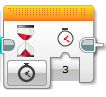
Wait Blocks
Wait blocks make your program pause for some time (or until something happens) before moving to the next step
For now, we are just going to wait for time
Choose Time for mode
Enter “3” for seconds to wait

Slide 50
DISPLAY BLOCK: CHALLENGE 2
Can you write a program to display text in the middle of the screen?
Display “Hello World”
Make the display block run for 3 seconds

Slide 51
DISPLAY BLOCK: CHALLENGE 3
Can you write a program to display text in the middle of the screen?
Display “Hello World”
Make the display block run for 3 seconds
Can you also move while doing this?

Slide 52
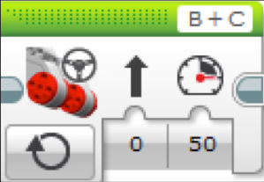
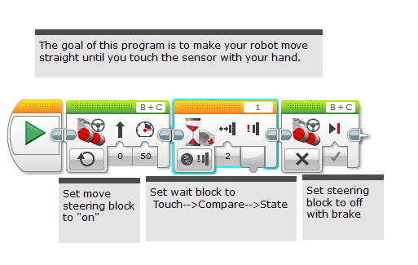
A tip for Move Steering Blocks With Wait Blocks
Leaving the motor “on” and “off”
Why use the “on” instead of “degrees”?
May want the program to do other tasks while moving

Slide 53
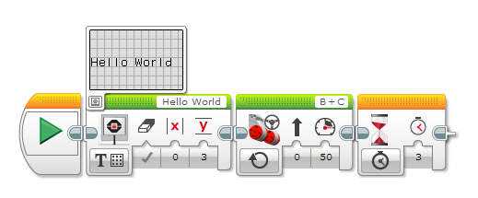
Challenge 3 solution

Slide 54
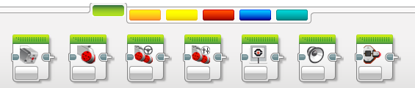
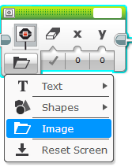
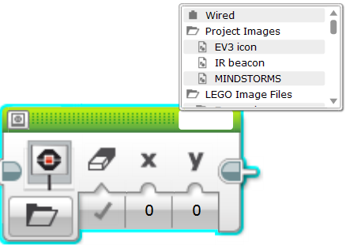
Displaying an image in PIXEL Mode
Step 1:
Pick Display Block
Step 2:
Click on the “Select Mode” which has a folder icon and pick “image”
Step 3:
Use the empty box on the top right to pick the image you want to display
Note: the image you choose may not show up correctly on a NXT

Slide 55
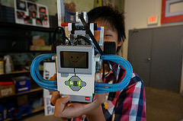
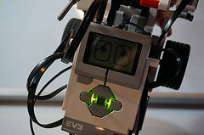
DISPLAY BLOCK CHALLENGE 4
Can you display eyes on the screen while moving? Alternate eyeballs that look left and right.
Use the Display Block, Motor On and Wait Block
Feel free to have fun with this challenge and make it yours!

Slide 56
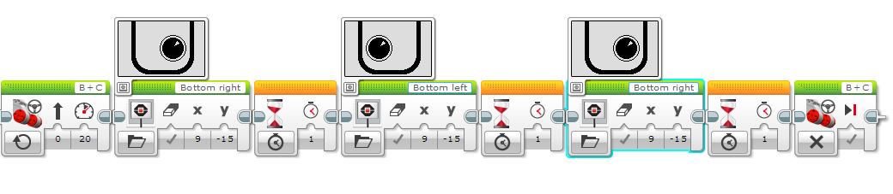
CHALLENGE 4 Solution
Motor On
Display Block
Wait Block
Motor Off

Slide 57
Discussion Guide update?
Why might you want to know how to use the display block?
You might want to know what the sensor value your robot is seeing
You might have to program a robot to stop when the robot reaches a red line but it stops before
Does the robot see the same thing you see?
You can display the value on the screen and check
It’s a great debugging tool. You can learn more about debugging code in one of our Intermediate lessons.

Slide 58
BEGINNER EV3 PROGRAMMING: Lesson Touch Sensor

Slide 59
Lesson Objectives
Make a robot that wanders the room – bumps into walls and turns around
Learn how to use the Touch Sensor
Learn the difference between the Wait For Block and the Sensor Blocks
Oops
B
B
B
C
C
C

Slide 60
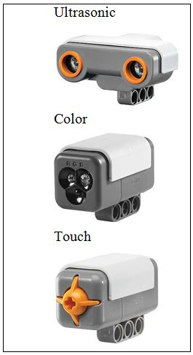
What is a sensor?
A sensor lets an EV3 program measure and collect data about is surroundings
The EV3 sensors include:
Color – measures color and darkness
Ultrasonic – measures distance to nearby surfaces
Touch – measures contact with surface

Slide 61
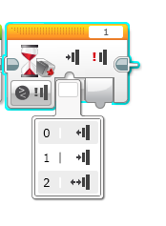
WHAT IS A TOUCH SENSOR?
Touch Sensor can detect when the sensor’s red button has been pressed or released
With this information, you can program an action when the sensor is:
Currently Pressed
Currently Released
Pressed and Released Just Before (Bumped)
When might you use this sensor?
Useful for programming “moving until touch sensor is pressed/released/bumped”
You can also have your program start or stop when a touch sensor is pressed.

Slide 62


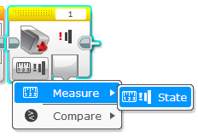
How do you program with the Touch Sensor?
There is a Touch Sensor Block in the Yellow Tab, but there is a Wait for Touch in the Orange Tab. What is the difference!!????!
Yellow Sensor Tab: Sensor Blocks
Used to Read and Compare Sensor Values
Orange Flow Tab: Wait for Block
Used to wait for a sensor reading (or time)
In this lesson, we will use the
Wait For Block

Slide 63
Reminder: A tip for Move Steering Blocks With Sensors
Leaving the motor “on” and “off”
Why use the “on” instead of “degrees”?
May want the program to do other tasks such as reading a sensor while moving

Slide 64

CHALLENGE 1
Program your robot to move straight until you tap the sensor with your hand.
B
0 = released
1 = pressed
2 = bumped
C
Hint: You will combine: Move Steering + Wait Block

Slide 65
Challenge 1 Solution
Add screenshot

Slide 66
CHALLENGE 2
Program your robot to move until it hits the edge of a wall. Then back up and turn right 90 degrees.
0 = released
1 = pressed
2 = bumped
B
C
Hint: You will combine Move Steering + Turning + Wait Block

Slide 67

Challenge 2 Solution
Add Screenshot

Slide 68
DISCUSSION
Why did you use MOTOR ON for these challenges?
You want to read the sensor while the motor is on.
Why do we use the WAIT FOR BLOCK in these challenges?
We need to program to wait for the correct reading
What is the difference between PRESSED, RELEASED and BUMPED?
PRESSED = pushed in, RELEASED = not pushed, BUMPED = pressed and released recently
What are some situations you might want to use each of these for?
PRESSED = running into a wall, BUMPED = tapped by hand RELEASED = no longer touching a wall

Slide 69
BEGINNER EV3 PROGRAMMING Lesson: Color Sensor

Slide 70
Lesson Objectives
FINISH
Make the robot move up to the green line without doing any measurement!
Learn how to use the Color Sensor
Learn about Coast and Brake
1
2
B
START
C

Slide 71
What is the color sensor?
What are they? Sensors that detect the intensity of light that enters it
Three modes: Color, Reflected Light Intensity and Ambient Light Intensity
Color Mode: Recognizes 7 colors (black, brown, blue, green, yellow, red, white) and No Color
Reflected Light: Measures the intensity of the light reflected back from a lamp that emits a red light. (0=very dark and 100=very light)
Ambient Light: Measures the strength of the light that enters the sensor from the environment. (0=very dark and 100=very light)
USES:
Move until a line
Follow a line
We will use COLOR MODE in this Lesson

Slide 72

COLOR SENSOR CHALLENGE
How do you make the robot move up to a green line using the color sensor?
Step 1: Use Wait For Color
Step 2: Use the color sensor in COLOR MODE
Hint: You will use Move Steering (think about motor on and off) and Wait for “Color”

Slide 73

Color Sensor Challenge Solution
FINISH
Move Steering
Set to “ON”
Move Steering
Set to “OFF” with BRAKE
Wait until Color is Green (#3)
START

Slide 74
BEGINNER EV3 PROGRAMMING Lesson: Loops
By: Droids Robotics

Slide 75
Lesson Objectives
Can we improve our baseball robot by just programming it to go to the “next” base and repeating this action?
Learn how to repeat an action
Learn how to use Loop Blocks
B
C
B
B
B
C
C
C
B
C

Slide 76

Repeating an Action
How can we move around bases using the commands we already know?
(move + turn) + (move + turn) + (move + turn) …
Loops make repeating a task multiple times easy
Is there an easier way?
Hint:

Slide 77
Loops
Loops make repeating a task multiple times easy
KEEP GOING….Forever, for a Count, Until touch (or something else)

Slide 78
LOOP CHALLENGE
Challenge: Write a program to go around bases until touched. You must use a LOOP

Slide 79

Loop CHALLENGE Solution

Slide 80
BEGINNER EV3 PROGRAMMING Lesson: Switches
By: Droids Robotics

Slide 81

Lesson Objectives
Get the robot to show a happy face when you press its button and a sad face when you don’t
Learn how to make your robot decide what to do out of different choices
Learn how to use a Switch Block

Slide 82

Switch Blocks
Run this code if the answer is yes
Asking the robot a question and doing something different based on the answer
Example: Does the robot see a line? Or not?
Basically a YES/NO QUESTION
Switch blocks are found in the orange/flow tab
The question being asked: is the touch sensor pressed
Run this code if the answer is no

Slide 83

Switch Block CHALLENGE 1
Challenge: Write a program that changes the display based on if the touch sensor is pressed or not pressed.
If pressed, your EV3 is happy! Display a smiley face. If not pressed, the EV3 is sad! Display a sad face.
Hint: You will need to use the display block, loops and switch blocks!

Slide 84

Challenge 1 SOLUTION
Display Block
Touch Sensor
Selected
Wait Block
Loop
Display Block

Slide 85
Switch Block Challenge 2
Can you write a program that display big eyeballs if you touch it once and a sad face if you touch it a second time and toggles back and forth.

Slide 86

Challenge 2 solution

Slide 87
BEGINNER EV3 PROGRAMMING Lesson: Ultrasonic Sensor
By: Droids Robotics

Slide 88

LESSON OBJECTIVES
Make a robot that follows you around like a dog
Learn about the Ultrasonic Sensor
Learn how to use Wait Until Ultrasonic Block
Learn the difference between the Wait Until Ultrasonic Block and the Ultrasonic Block

Slide 89



ULTRASONIC
An ultrasonic sensor measures distance.
You use it when you need to make sure you are a certain distance away from a target.
The distance can be measured in inches or centimeters.
To read the ultrasonic sensor, you use the Ultrasonic Block. To use the ultrasonic to do an action until a distance, you use “Wait Until”
VS.
Read Ultrasonic
Wait for Ultrasonic

Slide 90

Ultrasonic Challenge 1
Challenge: Make the robot move until it is 5 inches away from the wall.
Step 1: Make a new program
Step 2: Set move to “on”
Step 3: Set wait block to use the Ultrasonic
Step 4: Set move block to “off”

Slide 91

Challenge 1 solution

Slide 92

Challenge 2: Dog Follower
If the robot is closer than 5 inches away from your hand move backward, otherwise move forward.
Step 1: Drag a loop from the orange tab
Step 2: Drag switch inside loop
Step 3: Set switch to Ultrasonic
Step 4: Set move steering block to ON and place in TRUE
Step 4: Set move steering block to OFF and place in FALSE

Slide 93

Challenge 2 Solution

Slide 94
BEGINNER PROGRAMMING Lesson: Basic Line Follower

Slide 95
LESSON OBJECTIVES
Learn how to make a robot follow a line
Learn how to get a robot to follow a line using Color Mode on the EV3 Color Sensor
Learn how to follow a line until a sensor is activated
Learn how to follow a line for a particular distance
Learn how to combine sensors, loops and switches

Slide 96
Instructor Notes
We used CyberBot (see EV3Lessons.com Robot Design page)
CyberBot has color sensors behind the wheel
Therefore, students will have to line follow backwards (negative power)
Programming a line follower on an NXT brick with an EV3 requires some adjustments
We found that Move Steering with an angle does not work with the NXT for pivot turns
Therefore, the code uses Large Motor blocks instead for turning

Slide 97

FOLLOW THE MIDDLE?
Humans want to follow the line in the middle.
Let’s have the robot do the same thing using the Color Sensor
What type of questions can we ask using this sensor
Are you on line or not?

Slide 98
If we are on black, keep going straight
If we are on white, turn left to get back to the line
Seems to work fine here…

Slide 99
If we are on black, keep going straight
If we are on white, turn left to get back to the line
OH NO… my robot is running away….
When the robot leaves the left side of the line, the program no longer works!

Slide 100
Line Following: ROBOT STYLE
Why could the Human follow the middle?:
They can see ahead.
They can see the whole line and its surroundings
They see both sides and which side they left
Why can’t the Robot do the same thing?:
Can’t tell right or left side of the line
How do we make sure the robot always veers off on the SAME SIDE of the line?
Instead of the middle, could the robot follow the “edge”?
So now the robot will fall off only the same side.
We will now show you how this works!

Slide 101
ROBOT LINE FOLLOWING Happens on the edges
Left side line following
If on black, turn left.
If on white turn right.
If on black, turn right.
If on white turn left.
Right side line following
The robot has to choose which way to turn when the color sensor sees a different color.
The answer depends on what side of the line you are following!

Slide 102
Starting the robot on the correct side
✗
✔
✔

Slide 103
Line Follower challenge 1
Step 1: Write a program that follows the RIGHT edge of a line.
If your sensor sees black, turn right
If your sensor sees white, turn left
Use loops and switches!
You will need to use Large Motor block in “ON” Mode.
You will need to control each motor (B and C) separately.
Step 2: Try it out on different lines.
B
B
C
C

Slide 104

Line Following challenge Solution
Q. Does this program follow the Right or Left side of a line?
A. The robot is following the Right Side of the line.
Notes:
Right side

Slide 105
CHALLENGE 1 SOLUTION
Q. This line follower goes forever. How do we make this stop?
A. Change the end condition on the loop.
Notes:
Right side

Slide 106
Line follower challenge 2
Part 1: Make a line follower that stops when you press the touch sensor
Part 2: Make a line follower that stops after it travels a particular distance

Slide 107


Challenge 2 SOLUTION: Sensor

Slide 108


Challenge 2 Solution: Particular distance

Slide 109
DISCUSSION GUIDE
Why is it important for the robot to follow the same side of the line?
The robot only knows to check if it is on or off the line.
This is a basic line follower. What are some things that were not good about this line follower? Do you think the line follower can be improved?
It wiggles a lot. Smoother line followers are described in the Advanced lessons.
What sensor measures how far you have travelled?
The rotation sensor used in Challenge 2 solution measures how much the wheels have turned.
How would you write a line follower that will stop when it sees a line? Or another color?
Change the loop exit condition to use the color sensor.

Slide 110
Final Challenge

Slide 111



Using EV3Lessons Training Mats
Line Follower Mat
Black line follower
Red line follower
Move until a certain color
Drive over all the colors and have the robot name the color
Have robots follow each other around the track, but stay 5inches away
Sensor Mat
Line follower races
Try your robot on different lines
Line follower until green
Line follow black then white
Go around the box
Start in green box and end in red without knocking over box (place light box in black rectangle)
Basic Mat

Slide 112
CREDITS
This tutorial was created by Sanjay Seshan and Arvind Seshan
More lessons are available at www.ev3lessons.com
This work is licensed under a Creative Commons Attribution-NonCommercial-ShareAlike 4.0 International License.

